Slide 1

Institut für Psychologie

Slide 2
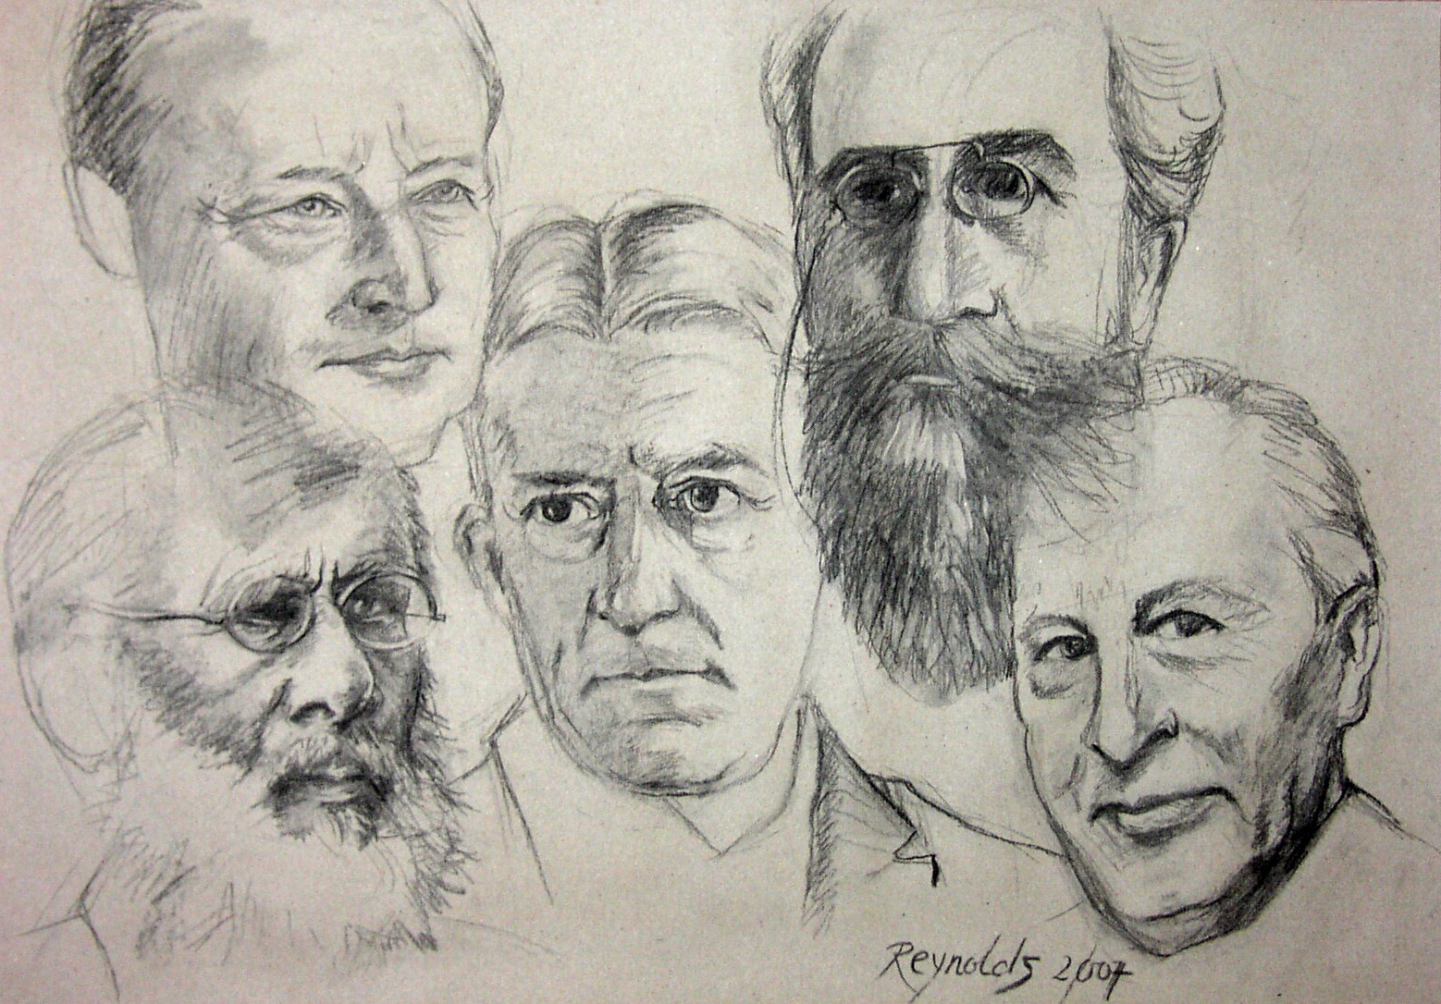
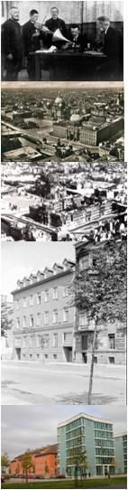
History of the
Institute of Psychology
Research Topics
Facilities
Memory, Perception (Herrmann Ebbinghaus)
Tone Psychology, Methodology, Applied Psychology (Carl Stumpf)
Gestalt Psychology (Wolfgang Köhler,
Max Wertheimer)
Topological and Developmental Psychology (Kurt Lewin)
Pedagogical Psychology and Typology (Kroh)
Gestalt Psychology, Personality Psychology and Twin Studies (Gottschaldt)
Cognitive, Mathematical Psychology, Psychophysics, Evolutionary Psychology (Klix)
today: interdisciplinary experimental and empirical psychology
1880
3 rooms, small apparatus collection
10 rooms, apparatus collection, phonogramm archive
25 (1921) – 41 (1935) rooms, best equipped psychological institute worldwide, seated in Emperors Palace
less than 40 rooms; destroyed 1945
41 rooms, best equipped psychological institute of both German states
60 rooms, best equipped psychological institute of East Germany
more than 200 rooms, 10 laboratories
1900
1920
1935
1950
1970
2000

Slide 3
Institute für Psychologie Facts and Figures
Staff
Facilities
14 Professorships
einschl. 1 Heisenberg Professor,
2 Junior Professors
2 Emmy-Noether Nachwuchsgruppen
4 S-Professuren (Max-Planck- Institute)
Wissenschaftliche Mitarbeiter (Haushalt)
42 Wissenschaftliche Mitarbeiter (Drittmittel)
Technische/Administrative Mitarbeiter
20 student assistants (regular budget)
56 student assistants (third-party funded)
3 919 m²
10 labs
◉ computer pool (25 places)
+ computer facilities at ESZ
4 lecture rooms + general rooms at ESZ
◉ mechanical shop floor
◉ library, integrated into the general library at ESZ
◉ test library (inhouse)
◉ outpatient clinic
◉ center for psychotherapy (postgraduate courses)

Slide 4
Institute of Psychology Professorships
Biological Psychology/ Psychophysiology | Werner Sommer
Clinical Psychology | Norbert Kathmann
Clinical Gerontopsychology (JP) | Katja Werheid
Cognitive Psychology | Elke van der Meer
Developmental /Pedagogical Psychology | Denis Gerstorf
Engineering Psychology / Cognitive Ergonomics | Hartmut Wandke
General Psychology | Peter Frensch / Torsten Schubert
Neuro-Cognitive Psychology (Heisenberg) | Rasha Abdel-Rahman
Social- and Organizational Psychology | Ursula Hess
Personality Psychology | Jens Asendorpf
Psychological Diagnostics | Matthias Ziegler
Psychological Research Methods | Oliver Lüdtke
Psychotherapy and Somatopsychology | Thomas Fydrich
Work Psychology (JP) | Annekatrin Hoppe

Slide 5
Institute of Psychology Facts and Figures
Third Party Funding

Slide 6
Institute of Psychology Students (n=772)
BSc. (274)
incl. minor
Diploma (498)
terms at university

Slide 7
Institute of Psychology beginners and graduates

Slide 8
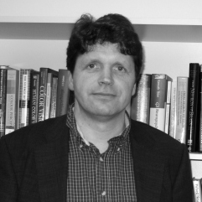

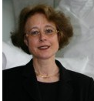

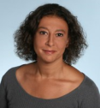
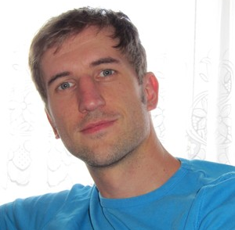
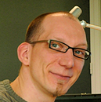
Bereich Kognitions und Neurowissenschaft
Methods
  Electroencephalogram (EEG)
  incl. EEG-Baby-Lab; ERPs, time-frequency analyses, connectivity analyses
  Peripheral physiology
  heart rate, SCR, EMG
  MRI
  structural, activity, connectivity analyses, DTI
Eye Tracking / Pupillometrics
gaze fixation, saccades
Psychophysics / Psychometric Measures processing speed, accuracy, gestures
Computational modeling
General Psychology
Cognitive Psychology
Biological Psychology and Psychophysiology
Neurocognitive Psychology
Active Vision & Cognition
Numerical Cognition

Slide 9

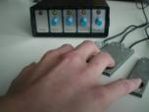
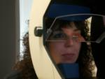
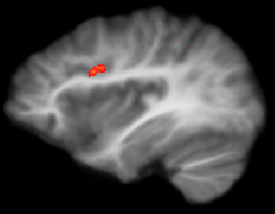
General Psychology
Prof. Peter A. Frensch
Prof. Torsten Schubert
Research Topics
Lab Facilities and Methods
Cognitive conflicts, action regulation and cognitive training
(DFG Schubert, Frensch, Strobach; VW Foundation)
Processes of executive control, attention and non-conscious information processing
Functional neuroanatomy of executive functions (fMRI)
Training- and age-related plasticity of cognitive functions
Concept acquisition and knowledge change
(Cluster of Excellence BWG: Schubert, Frensch, Gaschler, Scholz (Biology); DFG)
Acquisition, application and change of conceptual mathematical and biological knowledge
Learning, instruction and coding of actions (DFG Wenke, Frensch)
Implementation of instructions for action control
Agency and the acquisition of action-effect
couplings in action control
Behavioral analyses
processing speed
accuracy
postural responses
Eye Tracking
gaze fixation, saccades
Computational modeling
processing times, errors
fMRI
BOLD response
activation patterns
connectivity analyses

Slide 10
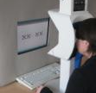

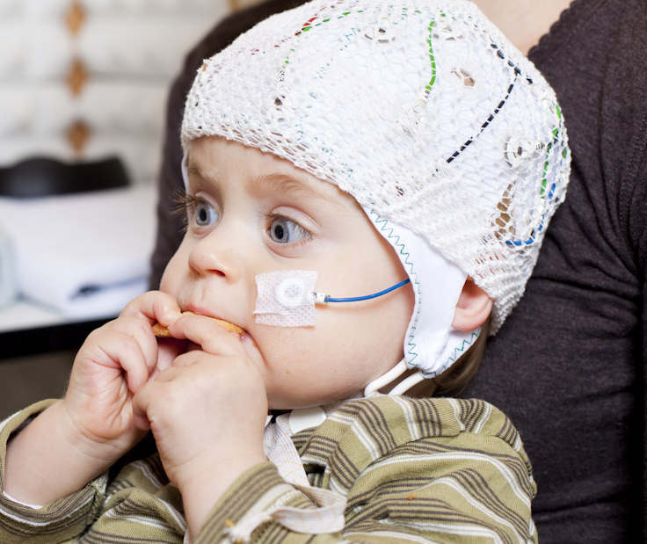
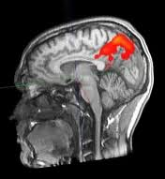



Cognitive Psychology
Prof. Dr. Elke van der Meer
Research Topics
Lab Facilities
Mathematical cognition: Cerebral correlates and sources of individual differences (intelligence, strategies) (BMBF)
Impact of chronotype and time perspective on cognitive abilities over the life-span (BMBF)
Social event knowledge: Understanding deficits (DFG)
Knowledge acquisition and sleep in infants, young children, and adults (DFG)
Brain functions and written language acquisition in school children (MPI-CBS, DFG)
Perception and appraisal of urban environ-ment; impact on human health (DFG; ECAV)
Behavioral Methods
processing speed
accuracy, gestures
Eye Tracking
processing strategies
Pupillometrics
cognitive resource
allocation
EEG-Baby-Lab
  time-frequency analysis
  source analysis
fMRI
activation patterns
structural scans

Slide 11
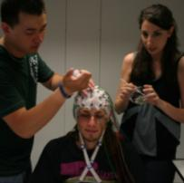
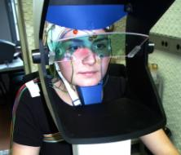

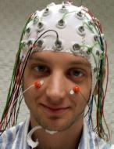
Biological Psychology and Psychophysiology
Prof. Werner Sommer
Research Topics
Lab Facilities
  Electroencephalogramm (EEG)
  Eye tracking
  Peripheral physiology
  Individual differences in processing emotion-al facial expressions (W. Sommer & O. Wilhelm; DFG)
  The timeline of reading (W. Sommer & R. Kliegl; DFG)
  Dynamical modeling of complex networks from EEG (W. Sommer, J. Kurths & G. Ivanova; DFG)
  Implicit activation of memory and actions: Automatic or capacity dependent? (C. Lehle; DFG)
  Neural underpinnings of individual differ-ences in cognition (W. Sommer, C. Zhou; DAAD)

Slide 12
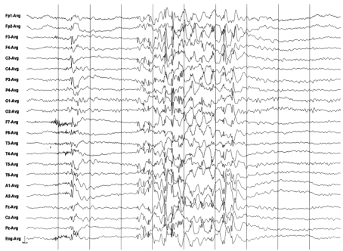
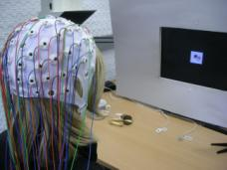
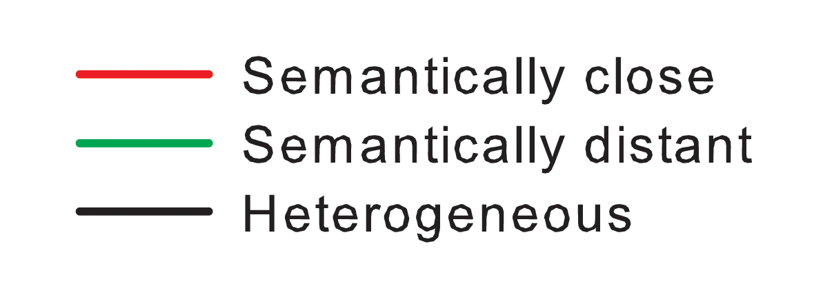
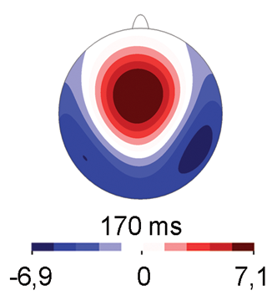
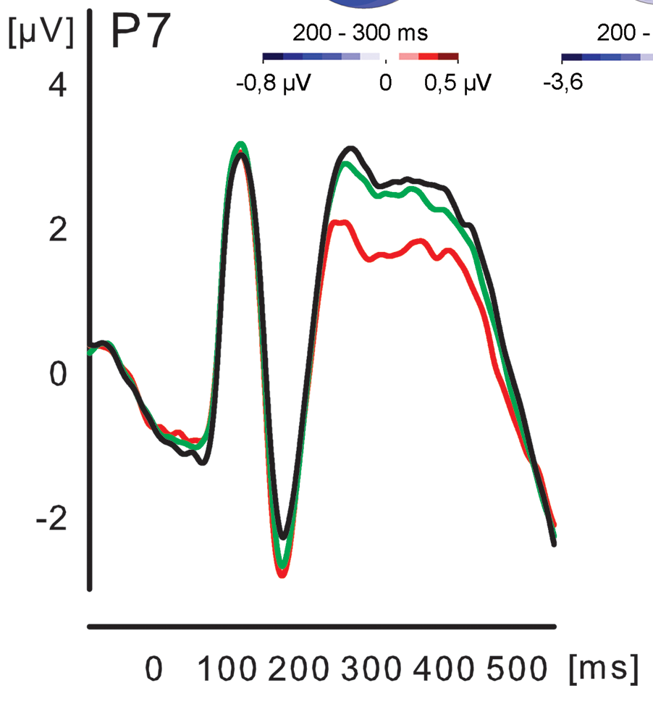
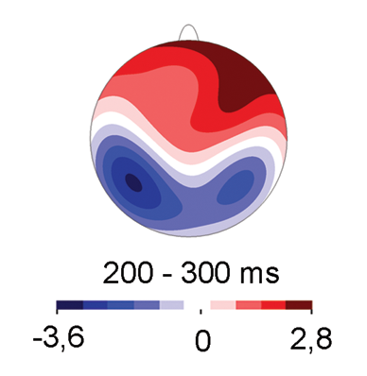
Neurocognitive Psychology
Prof. Rasha Abdel Rahman
Research Topics
Lab Facilities and Research Methods
Language production
  Dynamic and flexible aspects of semantic processes during lexical access
  Time course and microstructure of the language production and comprehension system
  Influence of affective stimulation and mood on lexicalization
Top-down influences on perception
  How are basic perceptual processes affected by higher-level processes, e.g., semantic knowledge and the structure of our language?
Organization of the semantic system
  Acquisition, storage and use of meaning
  Structure and organization of the semantic system
  Event-related brain potential (ERP) technique
We employ behavioral and electrophysiological measures. To investigate the organization and time course of core cognitive processes and the interplay between these processes.

Slide 13
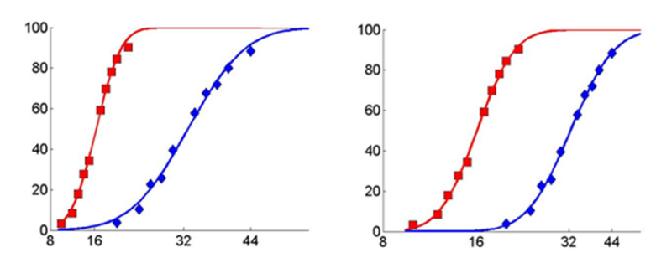
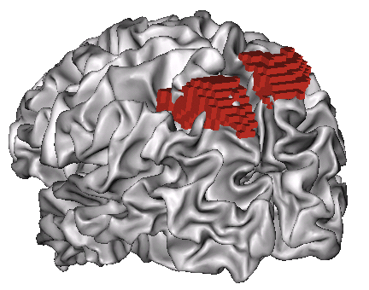
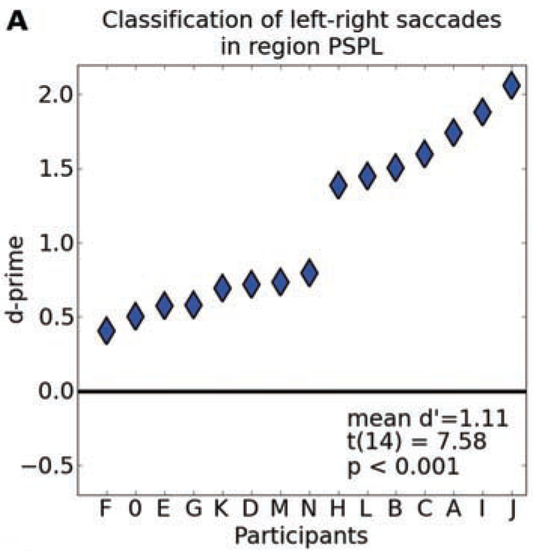
Emmy Noether Group
‚Numerical Cognition Unit‘
Dr. André Knops
Topics
Research Methods
  Numerical Cognition
  Neuro-functional & cognitive basis of mathematical reasoning
  Impact of the ‚number sense‘ on mathematical capacities
  Link between numbers and space
  Development of mental magnitude representatinon during childhood
  Developmental Dyscalculia
  Behavioral
  Reaction time & accuracy
  Psychophysics
  Psychometric Measures
  Neural level (fMRI)
  GLM
  MVPA
  (Decoding)
  Connectivity
  DTI
Standard 16
Standard 16
% larger responses
Standard 32
Standard 32
Displayed numerosity

Slide 14
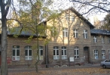

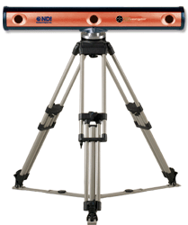
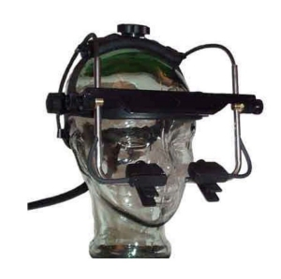
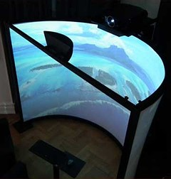
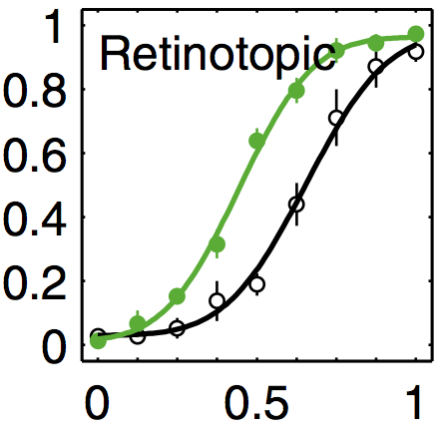

Emmy Noether Group
Dr. Martin Rolfs
Active Vision & Cognition
Research Topics
Lab Facilities
Attentional processes in active vision
  Dynamics of visual attention during unconstrained eye-head gaze shifts
  Modeling of neural & behavioral data
Visuomotor learning and plasticity
Control and adaptation of goal-directed movements and their impact on perception
Visual cognition
Foundation of the perception of causality, animacy, and intentionality in visual processing
Combined eye and motion tracking
Ultrafast whole-field
visual stimulation
Psychophysics

Slide 15
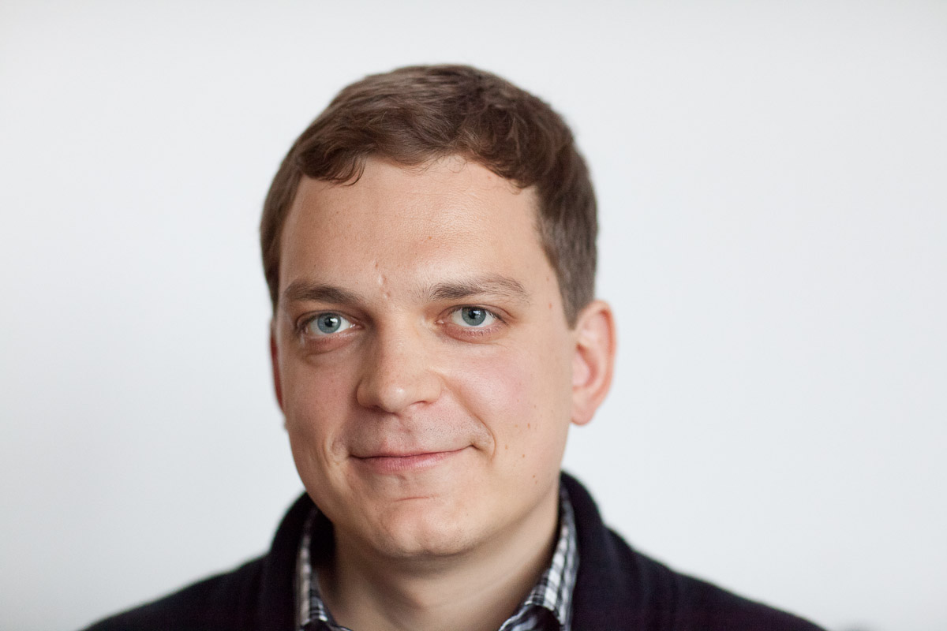
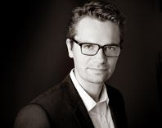
Bereich Psychometrie
Forschungsthemen
Simulationsstudien
Evaluation von statistischen Verfahren (z.B. Mehrebenenanalyse, Faktorenmodelle)
Methodik von Schulleistungsstudien Modellierung von Schülerkompetenzen, Behandlung fehlender Werte, Erfassung von Lernumwelten
Methodik von Persönlichkeitsstudien
Modellierung von Persönlichkeitseigenschaften, Wachstumsmodelle, Einfluss absichtlicher Verfälschung, Modellieren des Umwelteinflusses
Diagnostik
Methodenlehre

Slide 16
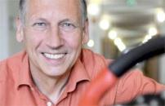
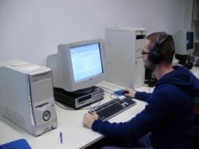
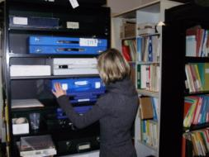
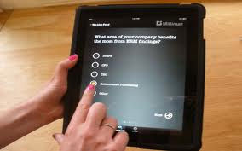
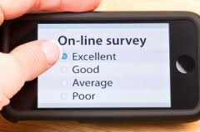
Psychological
Diagnostics
Prof. Matthias Ziegler
Research Topics
Lab Facilities
Abilities and Personality Traits in Learning across the lifespan
  Impact of fluid intelligence and Big 5 traits on learning and performance
  Interaction effects between these human characteristics
  Openness to experience as important influence variable
Faking in Personality Assessment
  Modelling the faking process
  Modelling faking impact
Person x Environment Interaction
  Measuring situational characteristics
  Modeling the interaction between situation perception and personality
Test development
  Generalizability theory
  Test length
  Computer based psychometric testing
  Test library
  Experience sampling

Slide 17
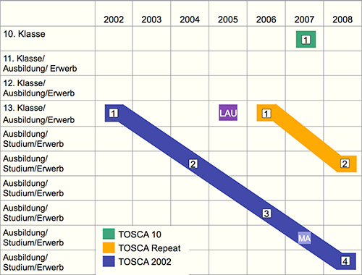

Psychological Research Methods
Prof. Oliver Lüdtke
Multilevel Modeling in Psychological Research
  Estimation and interpretation of contextual effects in multilevel models (Funding: DFG)
  Application of Bayesian techniques (e.g. Social Relations Model)
Methodology of Large-Scale Assessments
  Assessment of student achievement
  Missing data analysis (e.g., Multiple Imputation)
  Estimation of causal effects with non-experimental data (e.g., Propensity Score Matching)

Slide 18
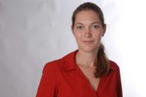
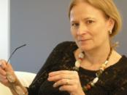
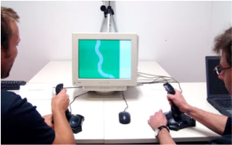
Work- Engineering- and Organisational Psychology
Methods
Field Studies
in the work setting
Experience sampling methodology/ diary studies
longitudinal designs for investigating long term effects of work characteristics on well-being
  Psychophysiology
  Heart rate, SCR, EMG, Cortisol
  Simulations
Work
Psychology
Social & Organizational
Psychology
  Socially Augmented Microworld
Engineering
Psychology

Slide 19
Work Psychology
Prof. Annekatrin Hoppe
Research Topics
Current Projects
Occupational Health Psychology (OHP)
  Stressors- resources- strain relationships in the work setting
  Occupational safety and health interventions/ Worksite health promotion
  Work analysis and work design
Immigrant and low wage workers
  Psychosocial working conditions and health low wage workers
  Ethnic health disparities
  Cultural diversity in teams
  Looking at the bright side of work:
  A diary study
  Day level resource-oriented interventions to improve personal resources, work engagement and well-being
  (Project partners: A. Michel, Universität Heidelberg, D. O’Shea, Limerick University/ Ireland, G. Gonzalez, Guelph University/Canada , A. Steidle, Universität Hohenheim)
  Labor migration of Spanish professionals to Germany
  (Project partners: K. Fujishiro, National Institute for Occupational Health, USA)

Slide 20

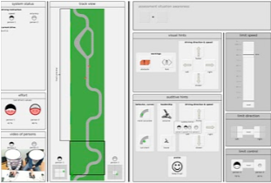


Engineering Psychology / Cognitive Ergonomics
Prof. Hartmut Wandke
Research Topics
Lab Facilities
Human Machine Systems (HMI)
  Function allocation and automation
  humans as operators in vs. as developers of HMIs
  (Funding: DFG Research Trainig Group prometei)
Ambient Assisted Living
  Social support of elderly people mediated by information technology
  Transgenerational User Interface Design
  (Funding: BMBF AAL Programme)
Sustainable Usability Engineering
  Methods and tools for early stages in Human Centred Design
  Integration of design stages by usability principles
  (Funding: artop GmbH)
  Experimental Display for Supervisory Control
  Socially Augmented Microworld

Slide 21



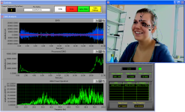
Social and Organizational
Psychology
Prof. Ursula Hess
Research Topics
Lab Facilities
A wrinkle in time: The perception of expressions in the elderly
The effect of wrinkles and facial folds on the perception of emotion expressions
(Funding: NIA Research Grant)
Empathic reactions to the elderly
Mimicry and Emotional contagion when observing the elderly
(Funding: DFG Research Grant)
Conflict at the workplace
Stress and emotion regulation in a conflictual dyadic work setting
(Funding: Interdisziplinäres Wolfgang Köhler-Zentrum)
Emotion comprehension and subjective wellbeing
A collaborative study with the University of Crete
(Funding: DAAD)
  Psychophysiology lab (EMG, HRV, IMP, EDA, BP, skin temp., Eye-tracker)

Slide 22


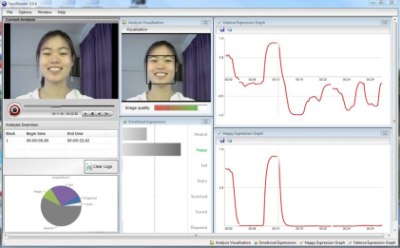
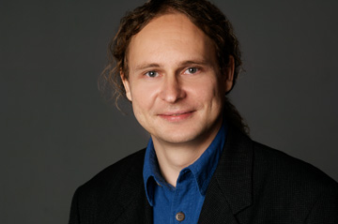

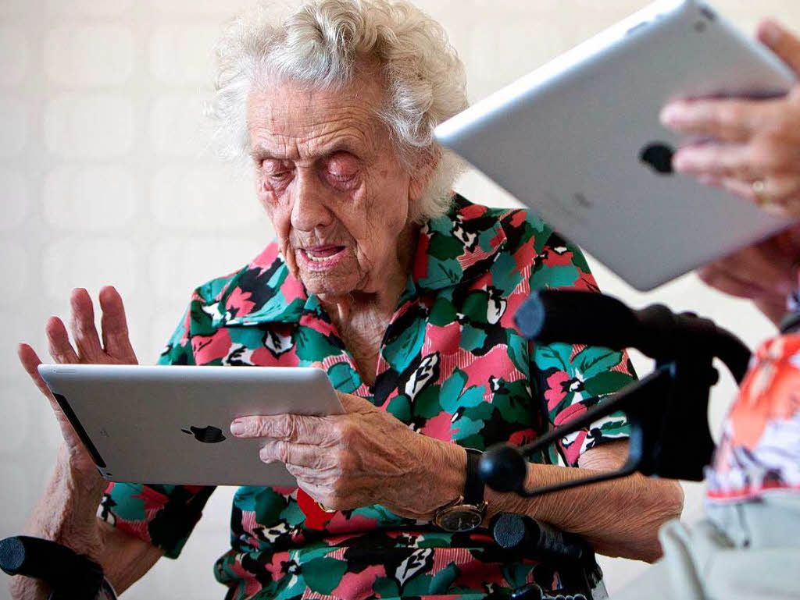
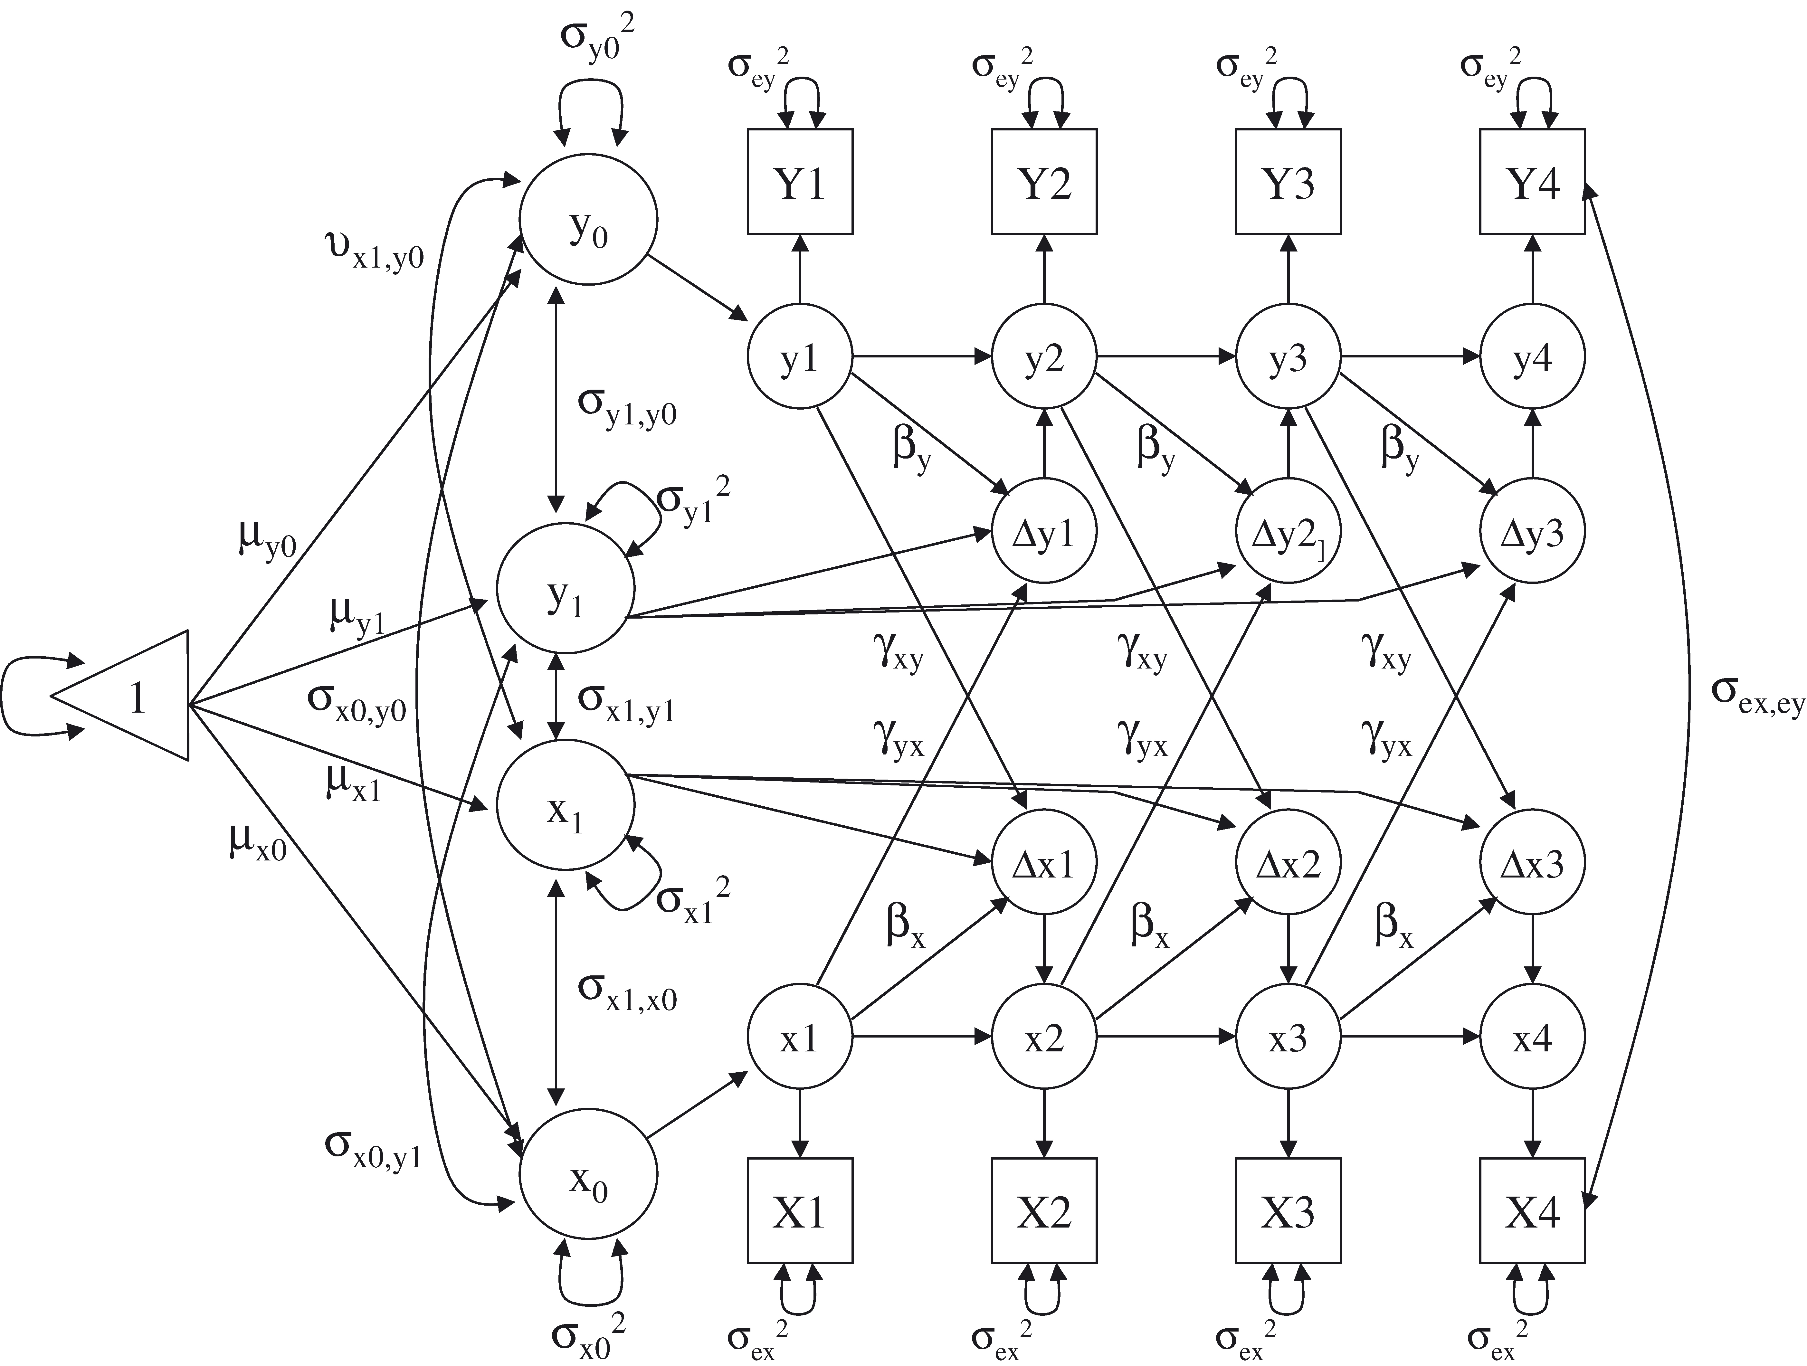
Lifespan Development
Methods
  high-definition video observation lab
  with computer-assisted coding facilities
psychophysiology lab (EMG, HRV, IMP, EDA, BP, skin temp., Eye-tracker)
in-situ assessments of everyday life
  contact people several times
  a day for an entire week
  physiological markers
  (e.g., stress)
applying longitudinal methods to large panel studies
  Germany: SocioEconomic Panel,
  Berlin Aging Studies I & II
  US: Health & Retirement Study
  UK: British Household Panel
Personality Psychology
Social & Organizational
Psychology
Developmental &
Educational Psychology

Slide 23




Personality Psychology
Prof. Jens B. Asendorpf
Research Topics
Lab Facilities
Empathic reactions to the elderly
  Individual differences in young people’s empathic reactions to emotional expressions of the elderly
  (Funding: DFG Research Grant)
Reassessment in the LOGIC Study
  Adjustment at age 29 as predicted from personality at ages 4-6 and later
  25-year German longitudinal study
  (Funding: Thyssen foundation)
Personality and Acculturation
  Longitudinal acculturation of exchange students to guest culture (GER,JAP,US)
  Longitudinal acculturation of immigrants to host culture in Greece (with University of Athens)
  High-Definition Video
  Observation Lab with
  Computer-Assisted
  Coding Facilities

Slide 24
Social and Organizational
Psychology
Prof. Ursula Hess
Research Topics
Lab Facilities
A wrinkle in time: The perception of expressions in the elderly
The effect of wrinkles and facial folds on the perception of emotion expressions
(Funding: NIA Research Grant)
Empathic reactions to the elderly
Mimicry and Emotional contagion when observing the elderly
(Funding: DFG Research Grant)
Conflict at the workplace
Stress and emotion regulation in a conflictual dyadic work setting
(Funding: Interdisziplinäres Wolfgang Köhler-Zentrum)
Emotion comprehension and subjective wellbeing
A collaborative study with the University of Crete
(Funding: DAAD)
  Psychophysiology lab (EMG, HRV, IMP, EDA, BP, skin temp., Eye-tracker)

Slide 25
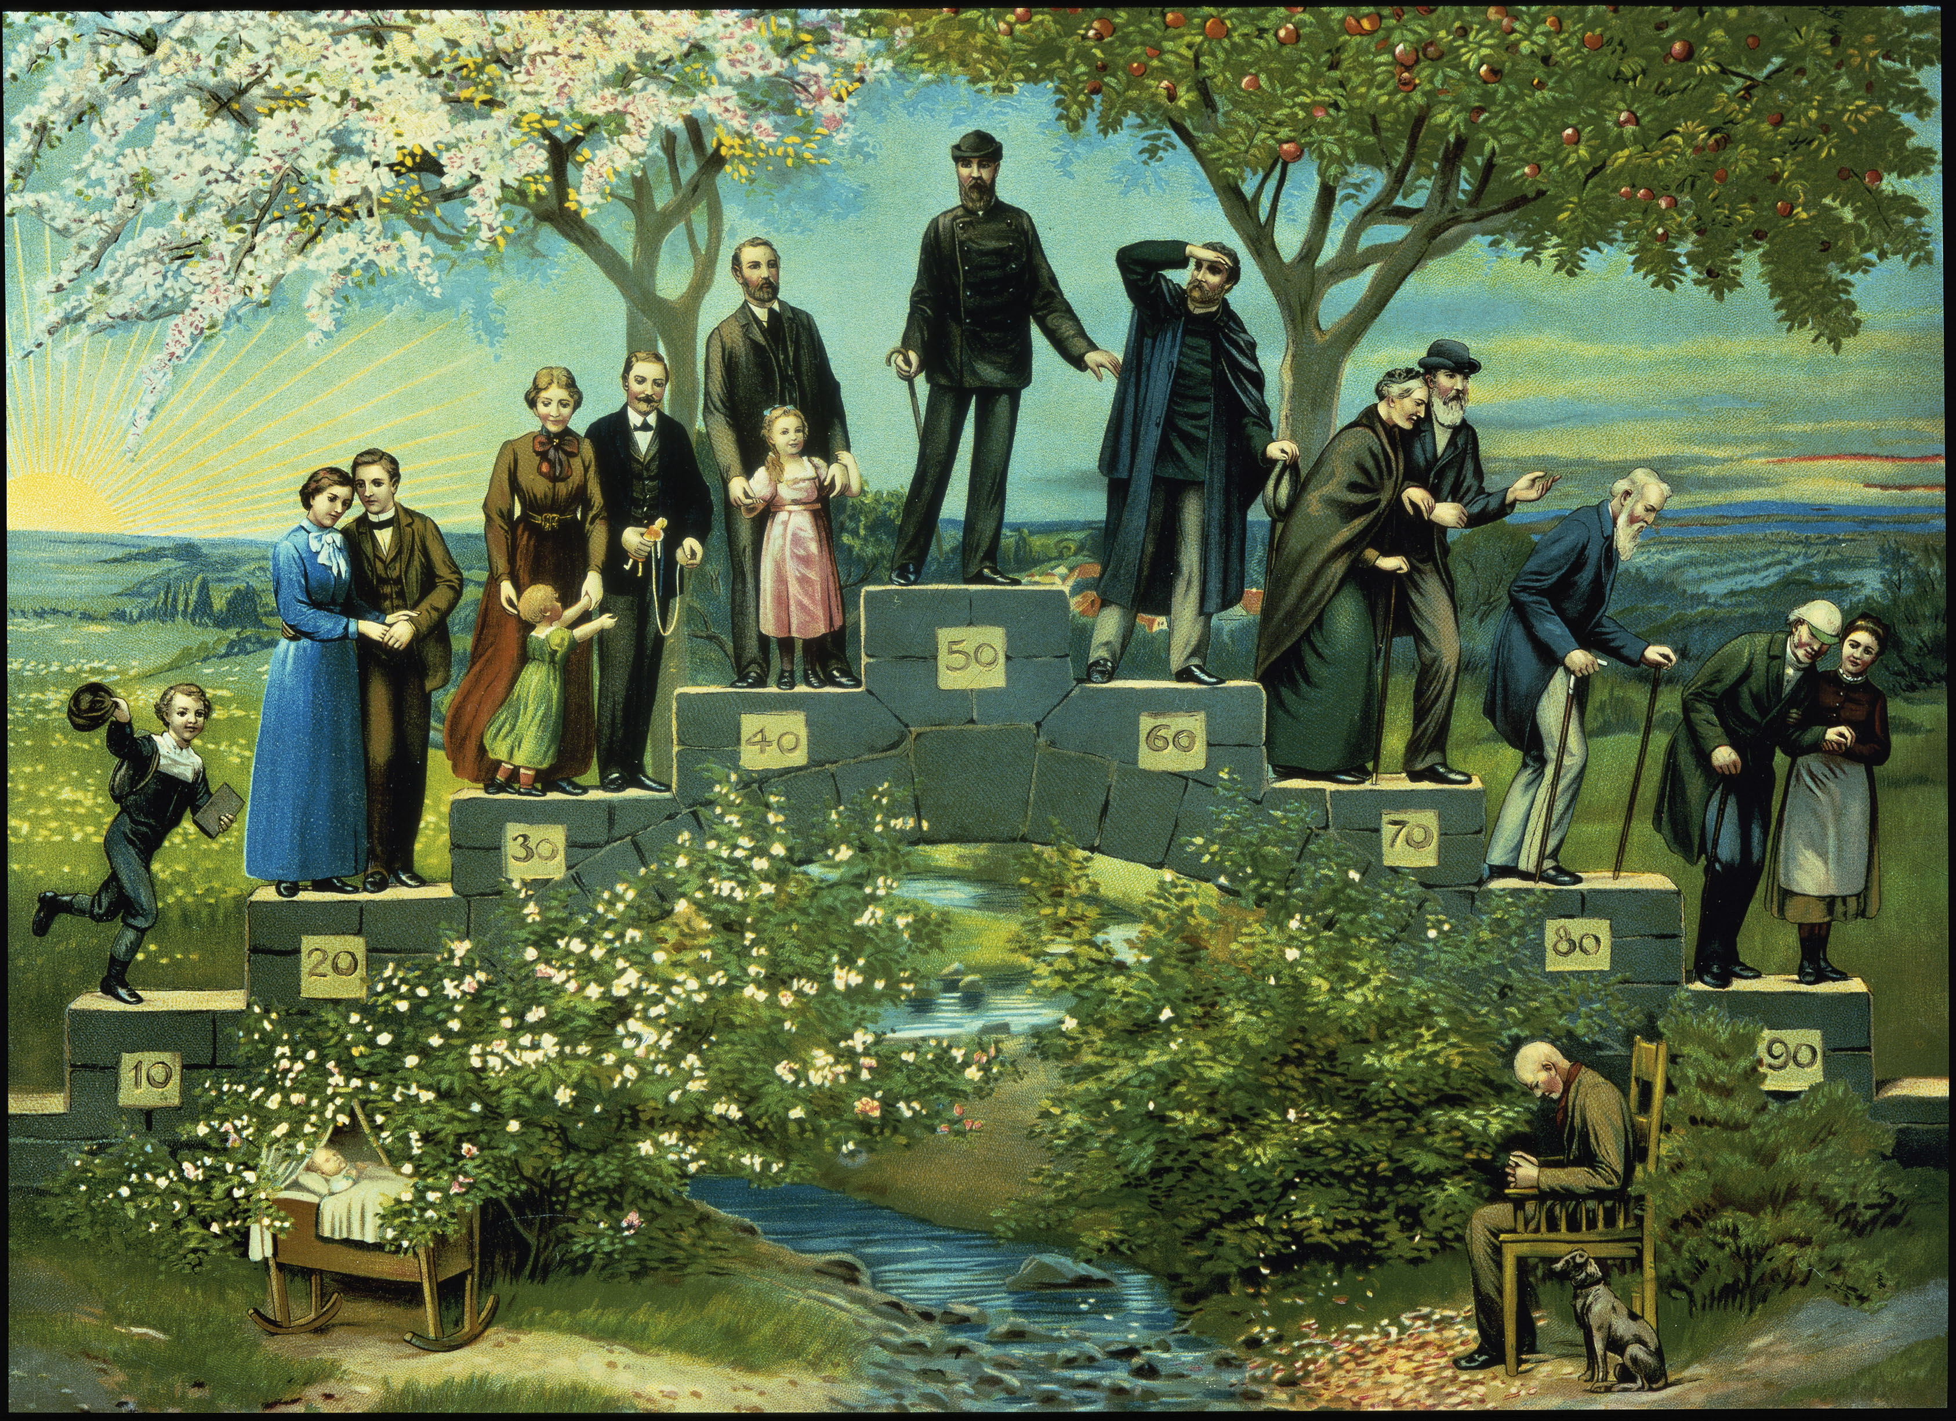


Developmental &
Educational Psychology
Prof. Denis Gerstorf
Research Topics
Methods
Differential Development across Adulthood
late-life change
  How is late-life well-being shaped by disease
  and impending death?
interrelations in behavioral change
  What are the developmental
  dynamics between well-being
  and cognitive functioning?
contextual effects on development
  How is well-being affected by characteristics of one’s partner?
daily life dynamics
  How do older adults master the challenges
  of everyday life?
applying longitudinal methods to large-scale panel studies
  Germany: SocioEconomic Panel,
  Berlin Aging Studies I & II
  US: Health & Retirement Study
  UK: British Household Panel
in-situ assessments of everyday life
  contact people several times
  a day for an entire week
physiological markers
  stress: cortisol

Slide 26
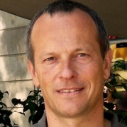
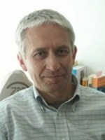

Bereich Klinische Psychologie
Klinische Psychologie (C4)
Themen und Methoden
  Welche (neuro-)psychologischen und –biologischen
  Veränderungen liegen Zwängen und Ängsten
  zugrunde ?
  Läßt sich “Vulnerabilität” für solche Störungen
  identifizieren ?
  Was verändert sich im Gehirn und im Verhalten
  unter Therapie ?
  Wie effektiv sind bestimmte Therapieformen ?
  Welche speziellen Probleme treten bei der
  Versorgung von Migranten auf ?
  Neuropsychologische Veränderungen im Alter
  Psychologische Interventionen bei Demenz und
  Schlafanfall
  Wir benutzen :
  EEG, (f)MRT, SCR, HR, Okulographie, Reaktionszeiten
Psychometrie, Computational modeling (Forschung)
Kognitive Verhaltenstherapie (Behandlung)
Psychotherapie und Somatopsychologie (C3)
Klinische Gerontopsychologie (W1)

Slide 27





Clinical Psychology / Outpatient Care Unit
Prof. Dr. Norbert Kathmann
Research Topics
Methods and Lab Facilities
Cognitive-affective mechanisms and brain dysfunctions in mental disease
  Performance monitoring
  Reward-based learning
  Decision making
  Volitional action
  Procedural learning
  Emotion regulation
  Agency
  Genetics
  (Funding: DFG /BMBF /VW Foundation)
Treatment of anxiety disorders
  Evaluation of treatment components
  Development of guidelines
Patient groups
  Obsessive-compulsive disorder
  Panic disorder
  Schizophrenia
Electroencephalography (EEG)
  Event-related brain potentials
  Time-frequency analysis
  Source analysis
Oculography
  (Anti-) Saccades
  Smooth-pursuit eye
  movements
Functional-/ Magnetic Resonance
Imaging (MRI & fMRI)
  BOLD Response (GLM) analysis
  Connectivity analysis
  Resting State Analysis
  Morphometry
  Simultaneous EEG/fMRI
Transcranial magnetic stimulation (TMS)

Slide 28

Psychotherapy and Somatopsychology
Prof. Dr. Thomas Fydrich
Research Topics
Staff / Facilities
Disorder-related research
  Social Phobia
  Personality Disorders
  Obsessive-Compulsive Disorder in children
  Depression and motivation
  Panic Disorder and Agoraphobia
  Quality assurance and evaluation of psychotherapeutic care
  Social support and health
  Homework assignments in psychotherapy
Mental health and culture
  Mental health care utilization and migration
  Transcultural aspects of mental disorders and psychotherapy
  Staff
    Dipl.-Psych. Kirsten Baschin
    Dr. Andrea Ertle
    PD Dr. Lydia Fehm
    Dr. Ulrike von Lersner
    Dipl.-Psych. Dominik Ülsmann
  ZPHU – Psychotherapy Training and Treatment Center
  Berlin-Mitte

Slide 29




Clinical Gerontopsychology
Prof. Dr. Katja Werheid
Research Topics
Lab Facilities
Affective processing in elderly people
  Psychophysiological experiments
  Emotion-memory interaction
  Structural parallelisms in language
  (Funding: DFG, BMBF, Languages of Emotion, Sonnenfeld Found.)
Psychological Interventions the Elderly
  Alzheimer disease/Mild Cognitive Impairment
  Stroke patients
  (Funding: BMG, Humor hilft Heilen)
  Post-stroke depression
  Pathogenesis
  Psychosocial risk factors
  Neurobiological risk factors
  (Funding: HU Berlin)
  EEG recording
  Behavioral experiments

